Slide 1
Predicting ridesharing price
David Bailey

Slide 2
David Bailey
M.S. Data Analytics student at WGU.
Director of operations and analytics, CBQ & co.

Slide 3


INTRODUCTION
Uber and Lyft are market leaders (Wong, 2021).
4.2 billion rides in the U.S. in 2018 (Mazareanu, 2020).
87% of users exclusively use only one service (Yeo, 2021).
Predicting competitor’s price would be an important competitive advantage.

Slide 4
Can Price be predicted from available factors?
H₀ – Factors do not affect and can’t predict price
H₁ – Factors do affect and can predict price

Slide 5
Available data
Ride
Distance
Surge Multiplier
Timestamp
Vehicle Type
Price
Weather
Temperature
Precipitation
Humidity
Wind Speed
Moon Phase
Service

Slide 6
Data Cleaning
1
Load the dataset into the statistical software, R.
2
Remove the 55,095 observations with no recorded price.
3
Remove variables that are duplicates or too similar.
4
Split the remaining 637,976 records into two data frames.

Slide 7
Analysis
ASSESS VARIABLES
BUILD MODELS
TEST MODEL PREDICTION
Which variables have a statistically significant effect on price and should be included in the model?
How much does each variable effect price?
For example, how much does price go up for each mile?
Test models on 30% of the datasets to compare predicted to actual prices.
How close are the predictions to actual values?

Slide 8
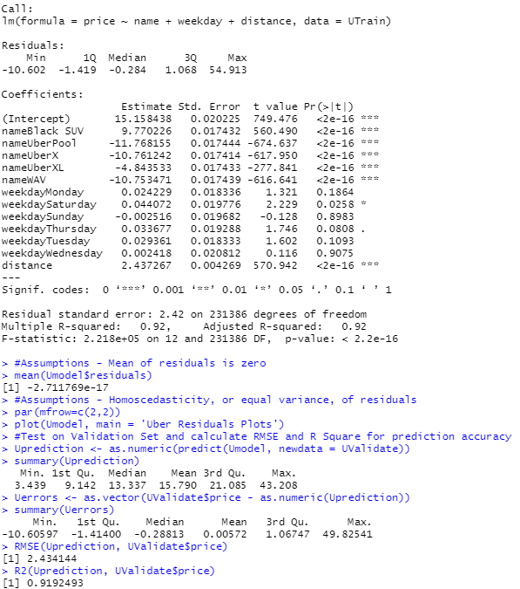
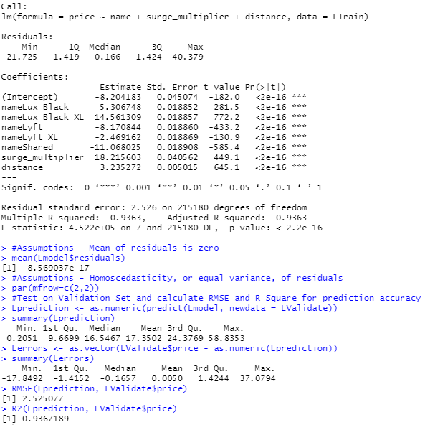
R Output

Slide 9
Findings
Uber
Type (Black XL) +$14.56
Predictive Accuracy
Uber
Significant Variables
Type of vehicle
Day of week
Distance
Lyft
Type of vehicle
Surge multiplier
Distance
Largest Coefficients
Lyft
Type (Shared) -$11.07
Surge (1-3) x$18.22
Uber
Type (UberPool) -$11.76
Type (Black SUV) +$9.77
Distance (miles) x$2.44
Standard error (RMSE): $2.43
Variance explained(R²): 91.92%
Lyft
Standard error (RMSE): $2.52
Variance explained(R²): 93.67%

Slide 10
Limitations
AVAILABILTY OF DATA
Additional variables might significantly affect ridesharing price.
A full year of observations would give more insight into weather’s effect on price.
Observations only available around Boston for the two-week period of Nov. ’18 – Dec. ‘19.
With more data, linear regression might not be the best model for prediction.

Slide 11
Proposed actions
Gather more data using the API to include other cities and states. Urban, suburban, and rural areas might share similar pricing even across state lines.
Run a similar regression model on recent observations since the outbreak of COVID-19. It is likely that average price saw a large drop and then a rise in 2021 (Yeo, 2021).
Determine if other data points are available, such as number of people currently seeking a ride and number of drivers currently available. These factors might also be significant.

Slide 12
Benefits of the study
Analysts at ridesharing services can use these models to predict competitor price in the Boston area and could deploy them with current observations, should they become available. This could help determine best day of the week for promotions, which vehicle types to promote, and distance priority.
Ridesharing users in the Boston area can use the linear model to predict pricing within $2.53, on average based on the available data.

Slide 13
Sources
Mazareanu, E. (2020, November 6). Statistics and facts on Lyft. Statista. https://www.statista.com/topics/4919/lyft/
Wong, S. (2021, July 20). Leading ride-hailing companies in U.S. by market share 2017-2021. Statista. https://www.statista.com/statistics/910704/market-share-of-rideshare-companies-united-states/
Yeo, L. (2021, July 14). Uber vs. Lyft: Who’s tops in the battle of U.S. rideshare companies. Bloomberg Second Measure. https://secondmeasure.com/datapoints/rideshare-industry-overview/d
Refer to my complete research paper, “Regression Analysis on Competitor Pricing for Ridesharing Market Leaders,” for more sources and in-depth explanations.

Slide 14
THANK YOU
David Bailey

